Slide 1
Sparse Representation Method
for Whole Graph Embedding
Oral Comprehensive Exam
Kaveen Liyanage
Dr. Bradley Whitaker
Dr. Rob Maher

Slide 2
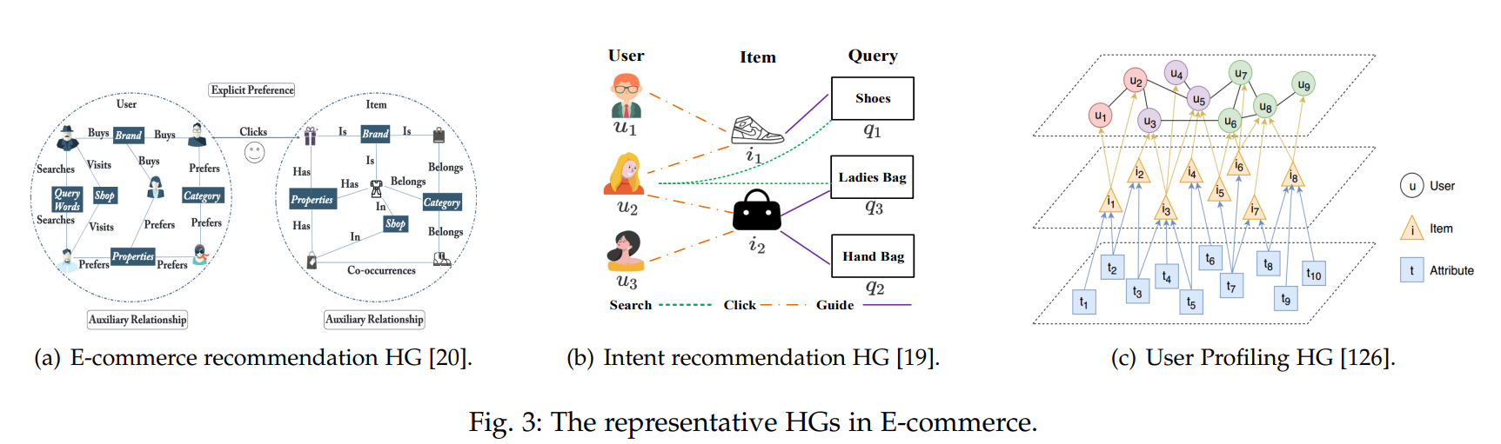
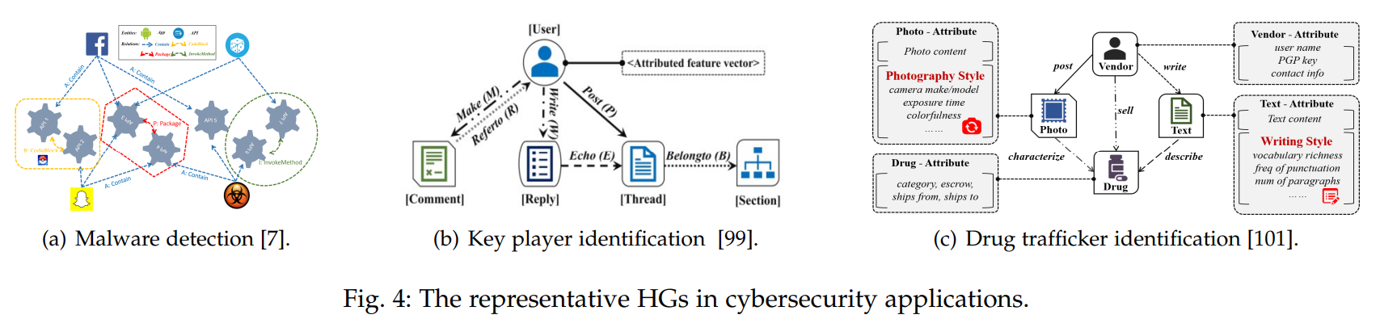
Graphs are helpful

Slide 3
Overview
Introduction
Motivation / Problem
Goal
Objectives
Background
Graph embedding
Sparse representation
Feature ranking
Workflow
Preliminary work
Proposed timeline
Future directions

Slide 4
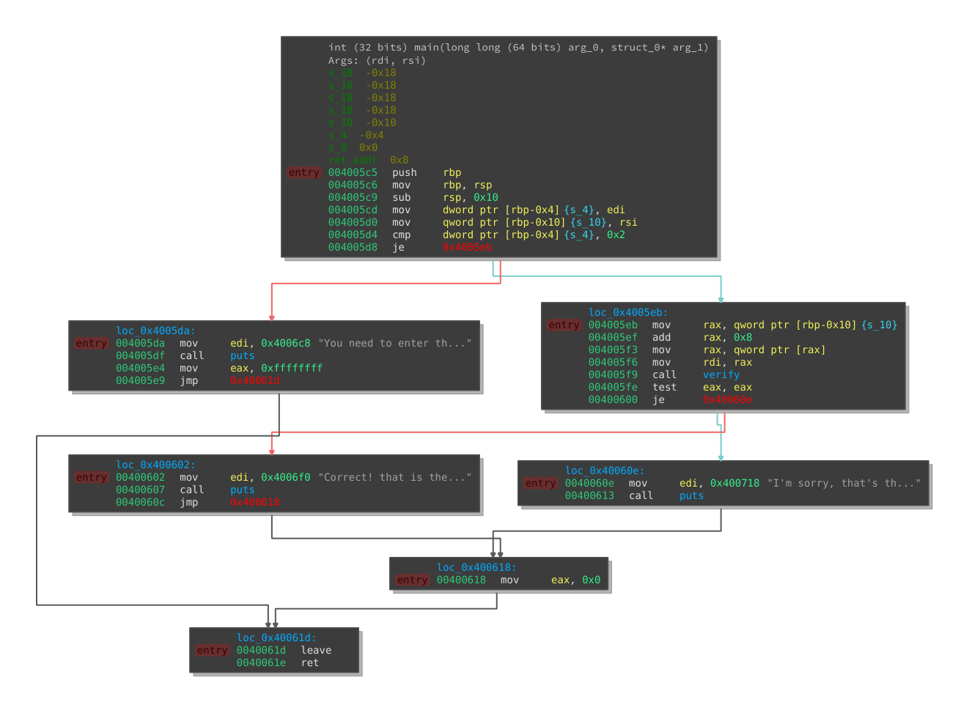
Malware detection by Control Flow Graphs (CFG) of binary files
402000 endbr64
402004 sub rsp, 0x8
402008 mov rax, qword ptr [0x409fd0]
40200f test rax, rax
402012 je 0x402016
402016 add rsp, 0x8
40201a ret
402014 call rax
402020 push qword ptr [0x409e70]
402026 bnd jmp qword ptr [0x409e78]
40202d nop dword ptr [rax]
402030 endbr64
402034 push 0x0
402039 bnd jmp sub_402020
40203f nop
402040 endbr64
402044 push 0x1
402049 bnd jmp sub_402020
40204f nop
402050 endbr64
402054 push 0x2
402059 bnd jmp sub_402020
40205f nop
402060 endbr64
402064 push 0x3
402069 bnd jmp sub_402020
40206f nop
402070 endbr64
402074 push 0x4
402079 bnd jmp sub_402020
40207f nop
402080 endbr64
402084 push 0x5
Python
angr library
Binary File
Control Flow Graph (CFG)

Slide 5
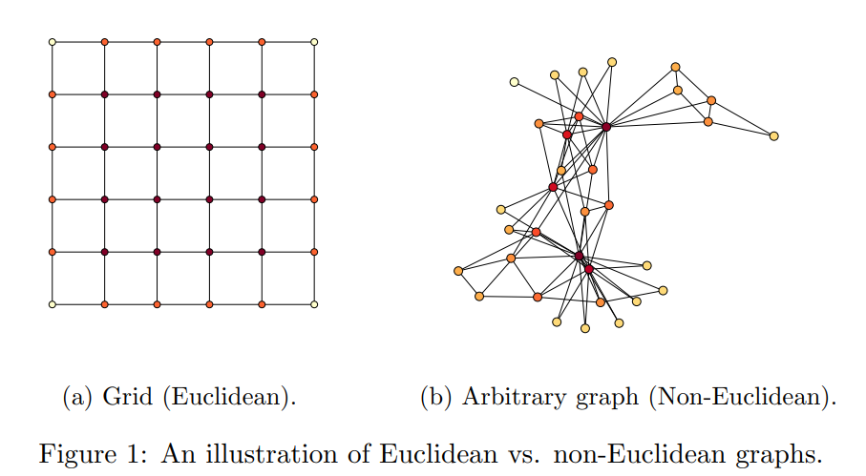
Graph embedding is an important process
Binary Files
Control Flow Graph (CFG)
Vector Representation
111010111011
Dimension | Prog1 | Prog2
1
2
3
4
5
6
..
Benign
101010101011
Malware

Slide 6
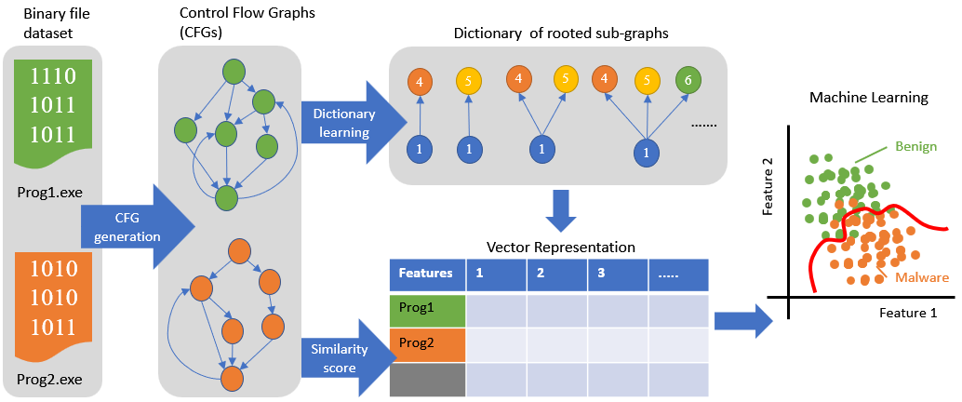
Overview of binary file analysis using CFGs

Slide 7
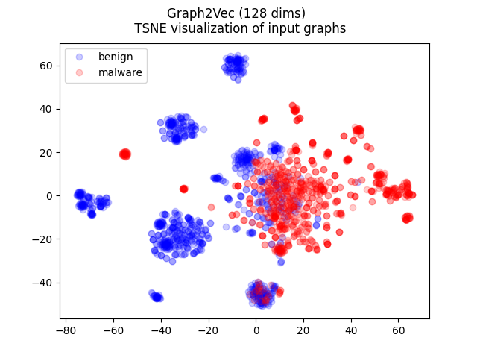
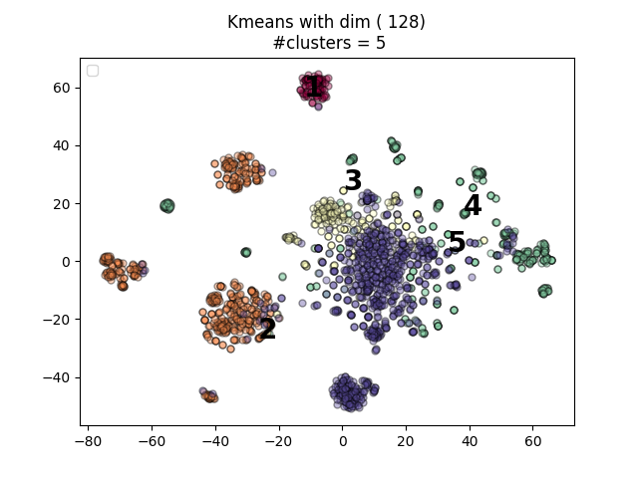
Unsupervised clustering of binary files using CFGs

Slide 8
Goal
Incorporate Sparse representation and its features for whole graph embedding.
A Graph is represented as one sparse vector and two graphs with similar sub- structure are embedded to be closer.
The Graph can be
Directed
Cyclic
Have node feature

Slide 9
Objectives
To develop a sub-tree pattern based sparse graph embedding method
WL+KSVD
Framework for Identifying important sub-tree patterns
Develop a sparse graph representation in hyperbolic space

Slide 10
Objectives overview
Graph Data
“Vocabulary” of rooted sub-graphs
Features | 1 | 2 | 3 | .....
Graph 1
Graph 2
:
4
5
4
5
4
5
6
Sub-graph
learning
1
1
1
1
4
1
5
Machine Learning
1
1
Dictionary learning
Feature 2
Feature 1

Slide 11
Objectives overview
Graph Data
“Vocabulary” of rooted sub-graphs
Features | 1 | 2 | 3 | .....
Graph 1
Graph 2
:
4
5
4
5
4
5
6
Sub-graph
learning
1
1
1
1
4
1
5
Machine Learning
1
1
2
Dictionary learning
Feature 2
Dictionary based
Feature Ranking
Feature 1

Slide 12
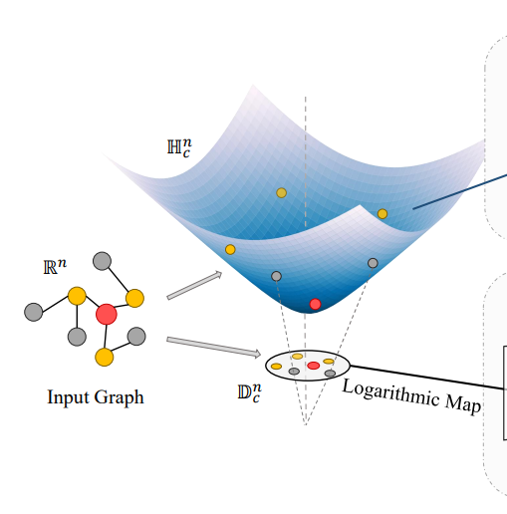
Objectives overview
3
Graph Data
Hyperbolic Dictionary learning
“Vocabulary” of rooted sub-graphs
Features | 1 | 2 | 3 | .....
Graph 1
Graph 2
:
4
5
4
5
4
5
6
Sub-graph
learning
1
1
1
1
4
1
5
Machine Learning
1
1
2
Dictionary learning
Feature 2
Dictionary based
Feature Ranking
Feature 1

Slide 13
Overview
Introduction
Motivation / Problem
Goal
Objectives
Background
Graph embedding
Sparse representation
Feature ranking
Workflow
Preliminary work
Proposed timeline
Future directions

Slide 14
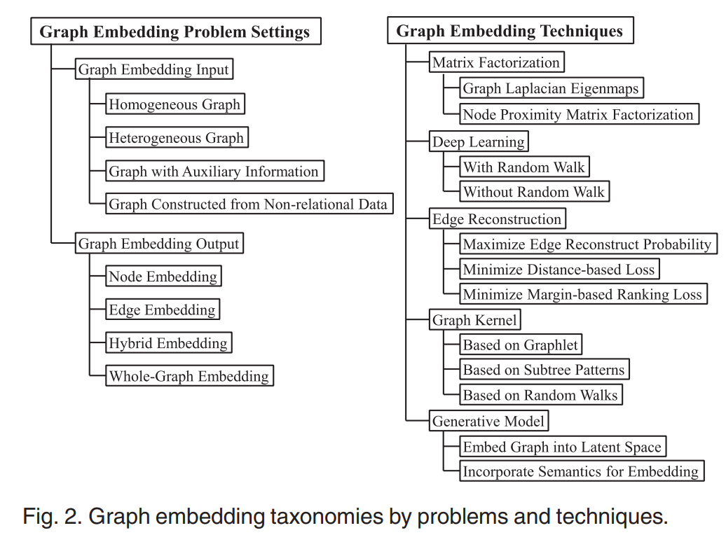
Graph embedding

Slide 15
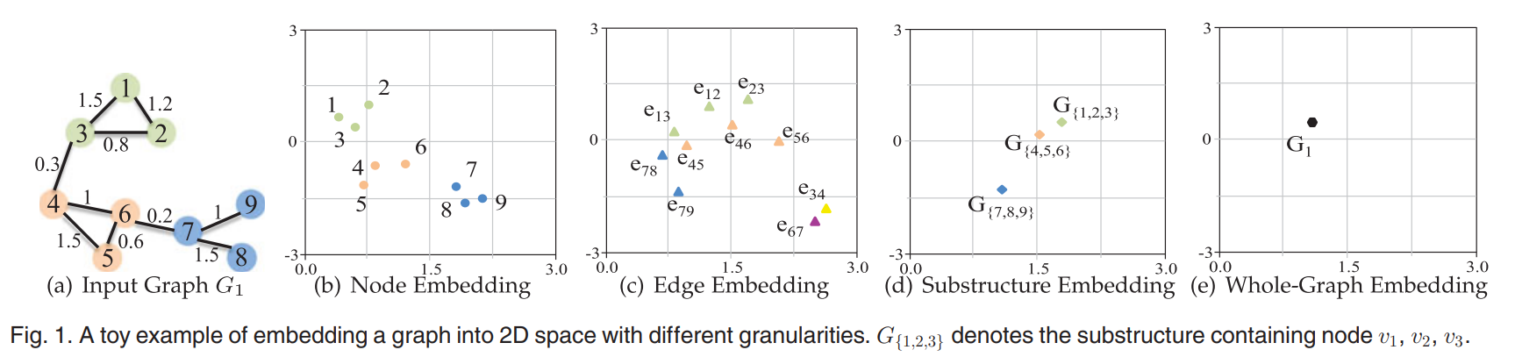
Graph embedding types

Slide 16
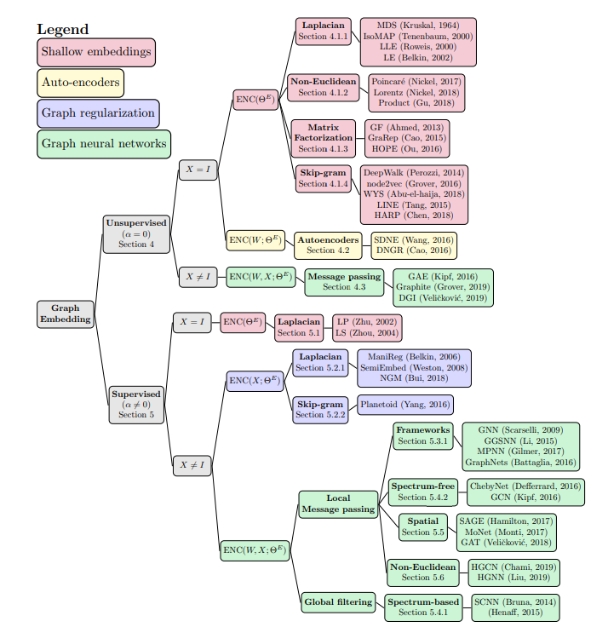
Graph embedding techniques

Slide 17
Graph2Vec overview
Start
if
load
Features | 1 | 2 | 3 | .....
Prog1
Prog2
:
WL hash words
[‘word2’ , ‘word5’, ‘word6’, …]
Doc2Vec
save
[‘word1’ , ‘word2’, ‘word3’, …]
print
[‘word1’ , ‘word4’, ‘word7’, …]
sub
func
*Proposed using
Sparse methods

Slide 18
Weisfeiler-Lehman subtree hash
CFG
Initial relabeling with number of neighbors
Relabeling after first iteration
Start
2
2, (2,4)
check
load
4
2
4, (2,2,2,4)
2, (2,2)
save
2
2
2, (4,4)
print
2, (2,4)
sub
func
4
4, (2,2,4,4)
Node | Word
Start | 2, hash(2,4)
check | 4, hash(2,2,2,4)
Load | 2, hash (2,2)
Save | 2, hash(4,4)
Print | 2, hash(2,4)
Sub_func | 4, hash(2,2,4,4)
… | ….

Slide 19
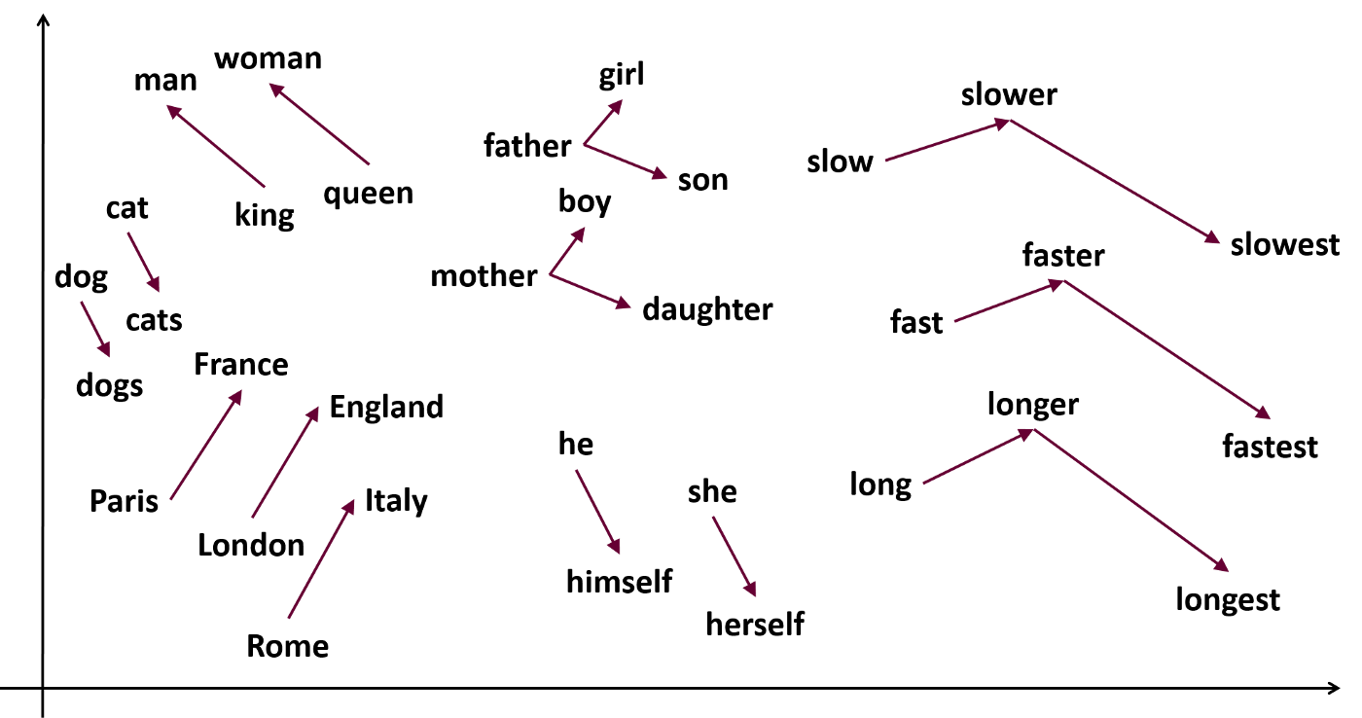
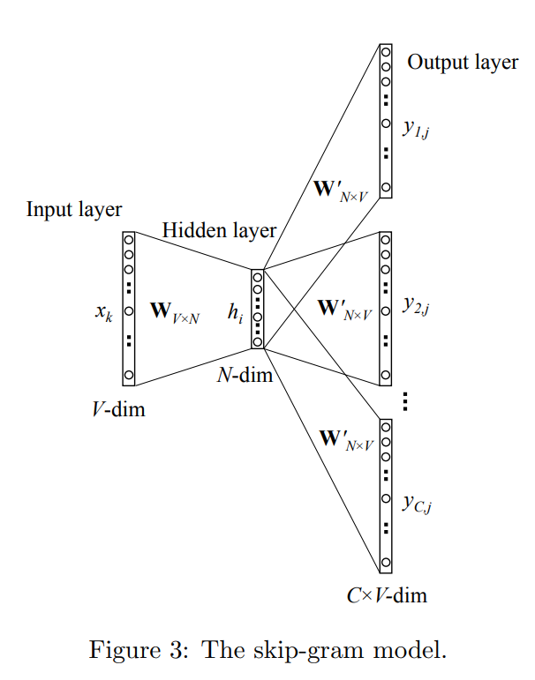
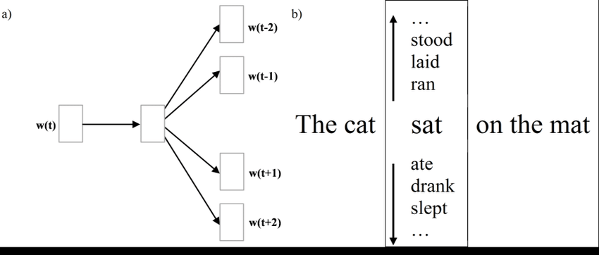
Word2Vec
https://ronxin.github.io/wevi/

Slide 20
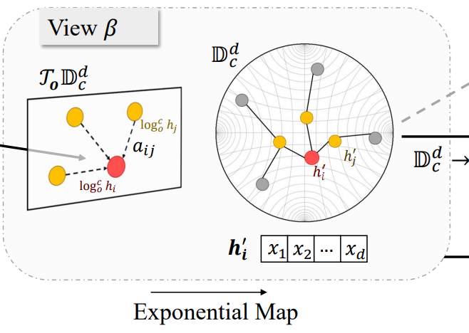
Poincare map

Slide 21
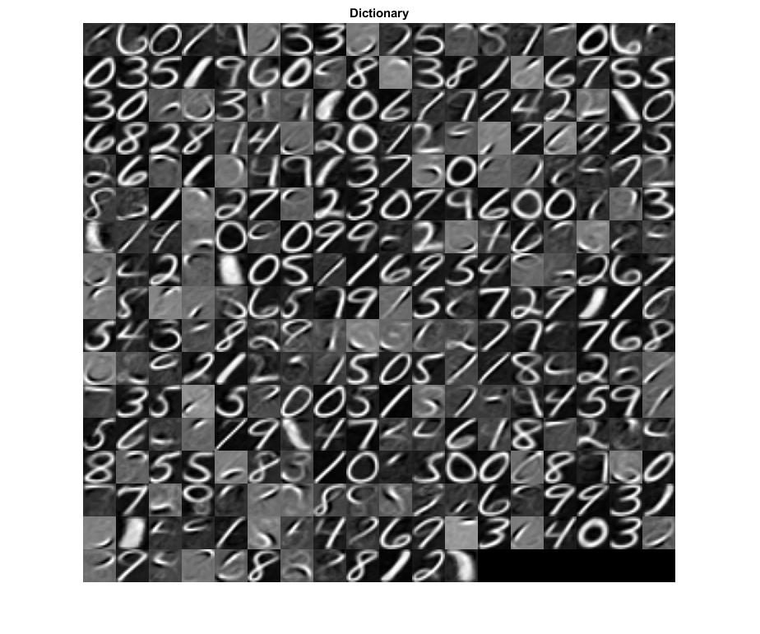
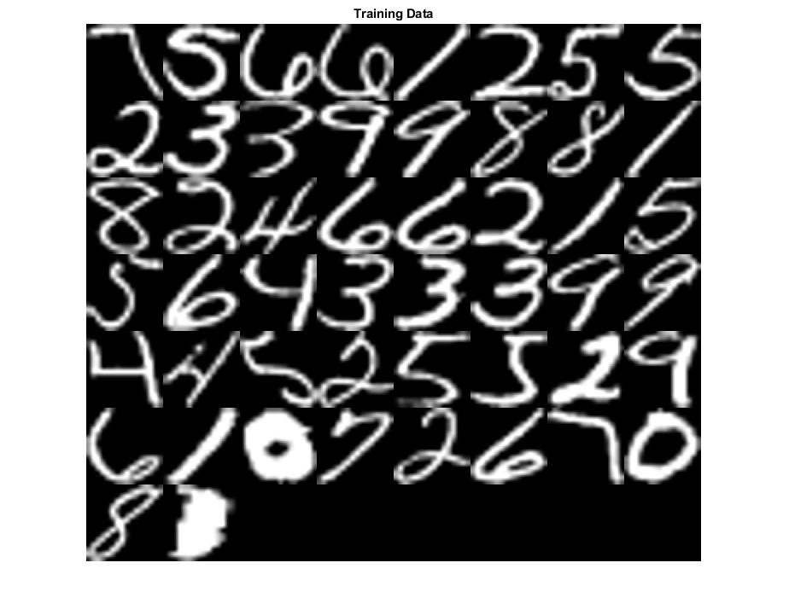

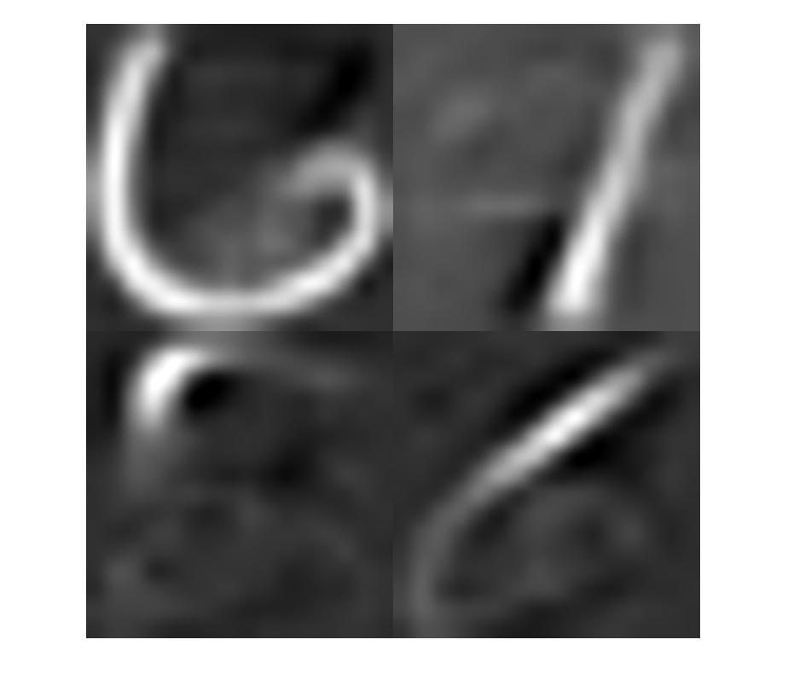



Sparse Representation
Input Data
Reconstructed Data
Learned dictionary
Dictionary atoms utilized
Sparse Coefficients
* 6.0793
$$≈$$
* 0.7727
* 2.2129
* -0.7443

Slide 22
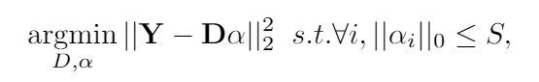
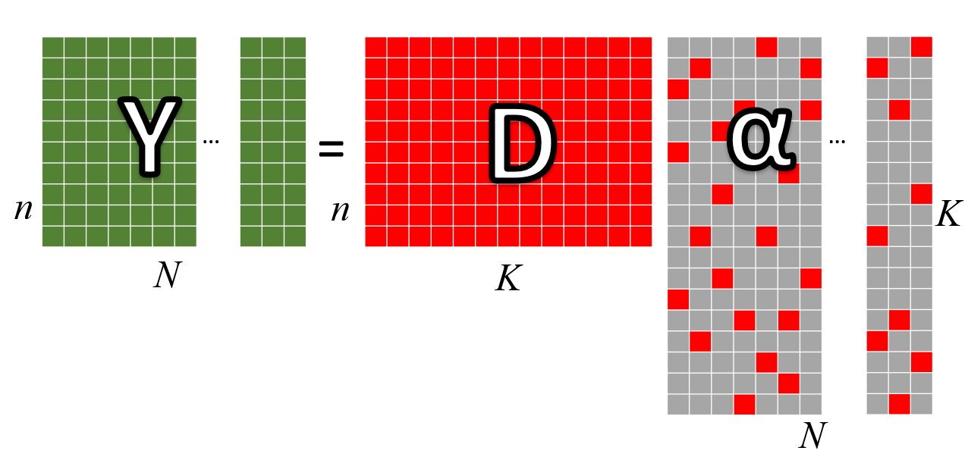
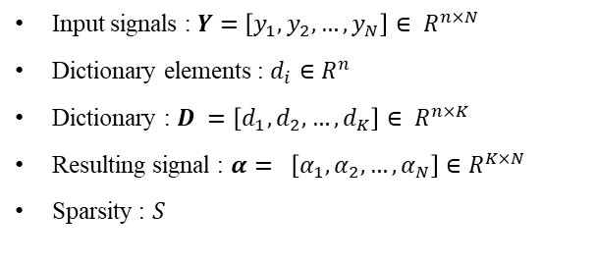
Sparse Representation
Input signals : $Y=\left[y_{1}, y_{2},…,y_{N}\right]∈ R^{n×N}$
Dictionary elements : $d_{i}∈R^{n}$
Dictionary : $D =\left[d_{1}, d_{2}, …, d_{K}\right]∈ R^{n×K}$
Resulting signal : $α= \left[α_{1}, α_{2},…,α_{N}\right]∈R^{K×N}$
Sparsity : $S$

Slide 23
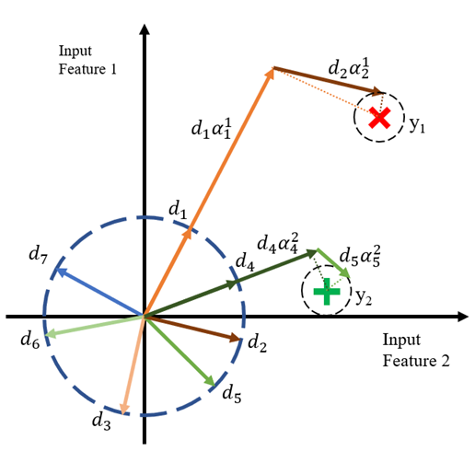
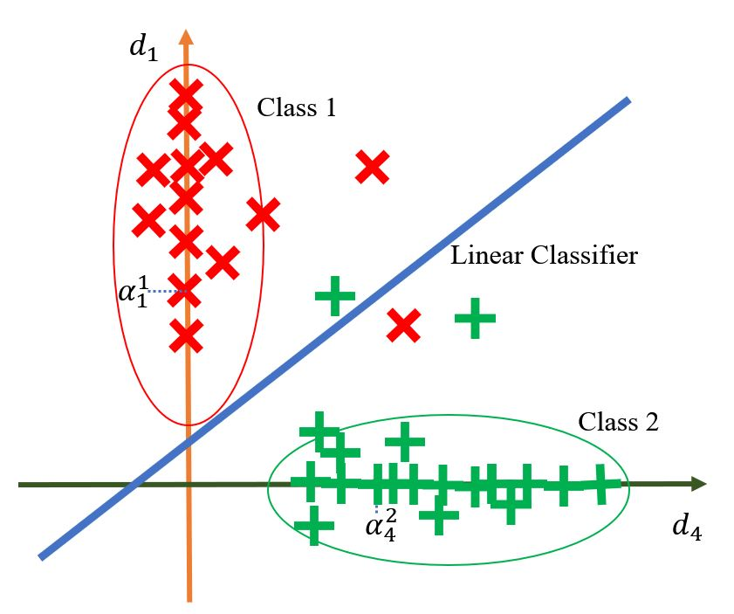
Learned dictionary is in the same input space
Input space
Dictionary space

Slide 24
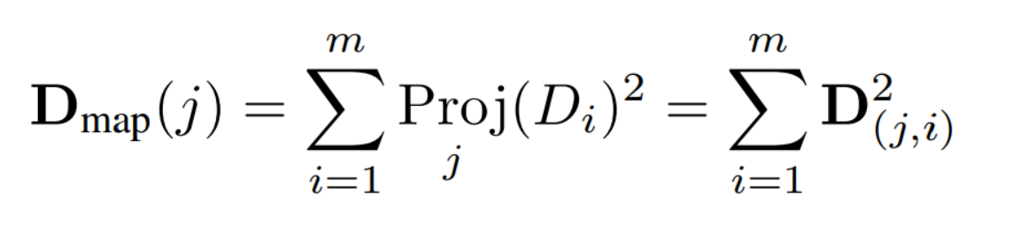
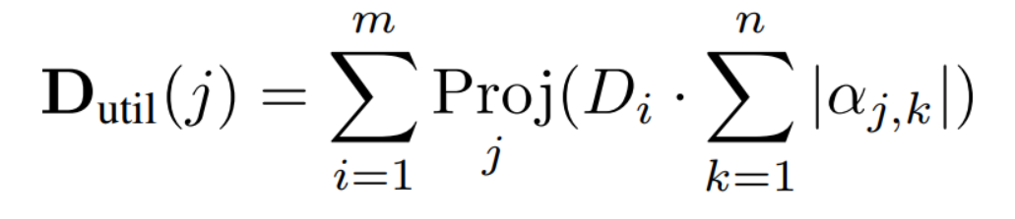
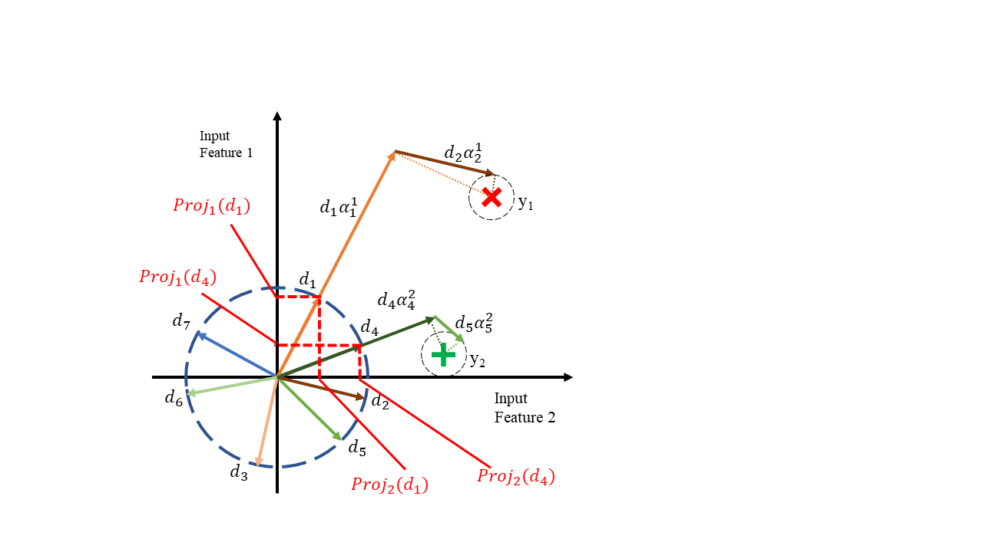
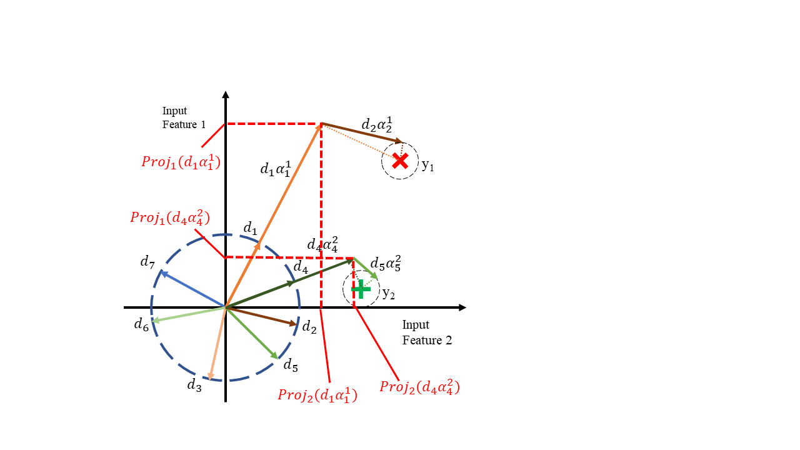
Dictionary based Feature Ranking metrics
Dictionary mapping
Dictionary utilization

Slide 25
Sparse coding-based FR
Pros
Model agnostic
Calculated Sparse coefficients can be used with different models
Simple relationship
More intuitive mapping
Non-myopic manner
Take into consideration correlations and redundancies
Cons
Time must be spent to compute the sparse coefficients
Time spent learning sparse coefficients is not wasted

Slide 26
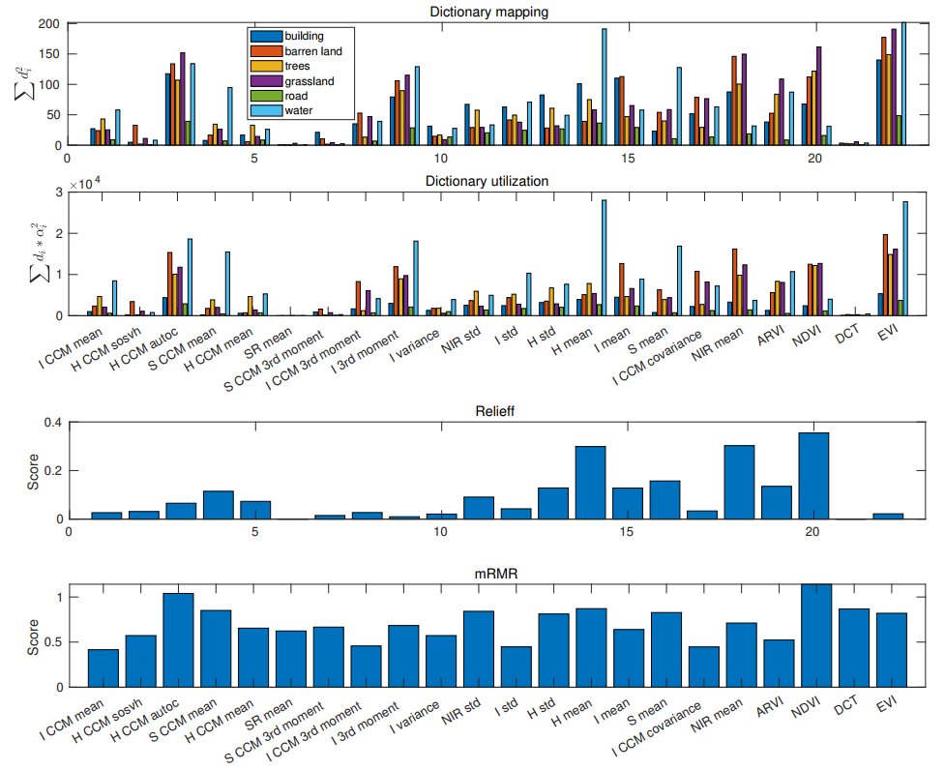

Slide 27
Overview
Introduction
Motivation / Problem
Goal
Objectives
Background
Graph embedding
Sparse representation
Feature ranking
Workflow
Preliminary work
Proposed timeline
Future directions

Slide 28
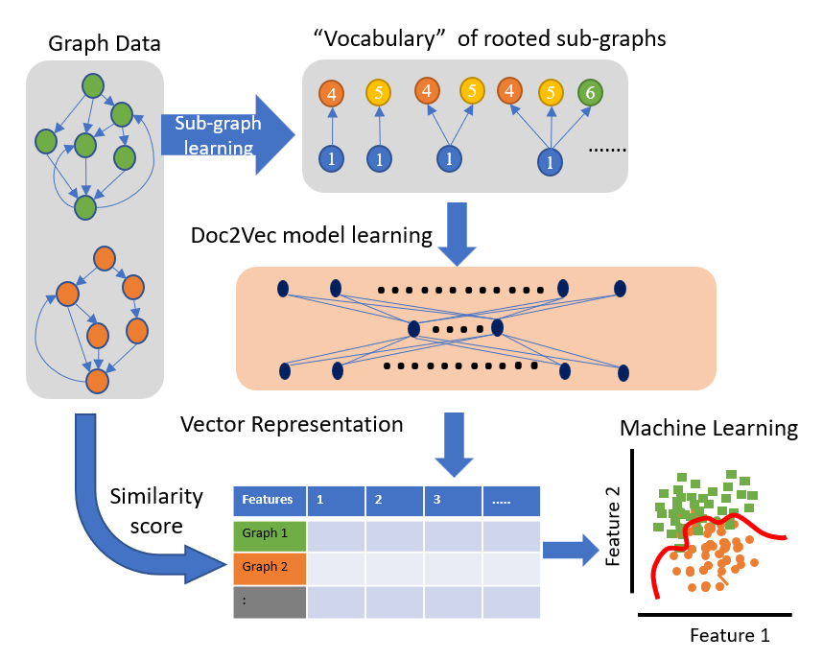
Graph2Vec

Slide 29
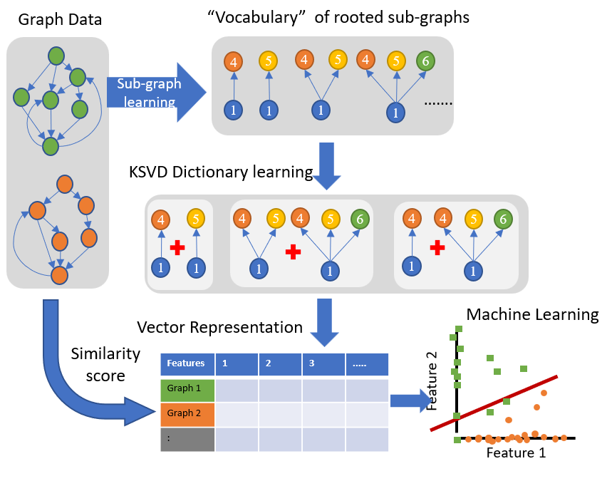
WL+KSVD

Slide 30
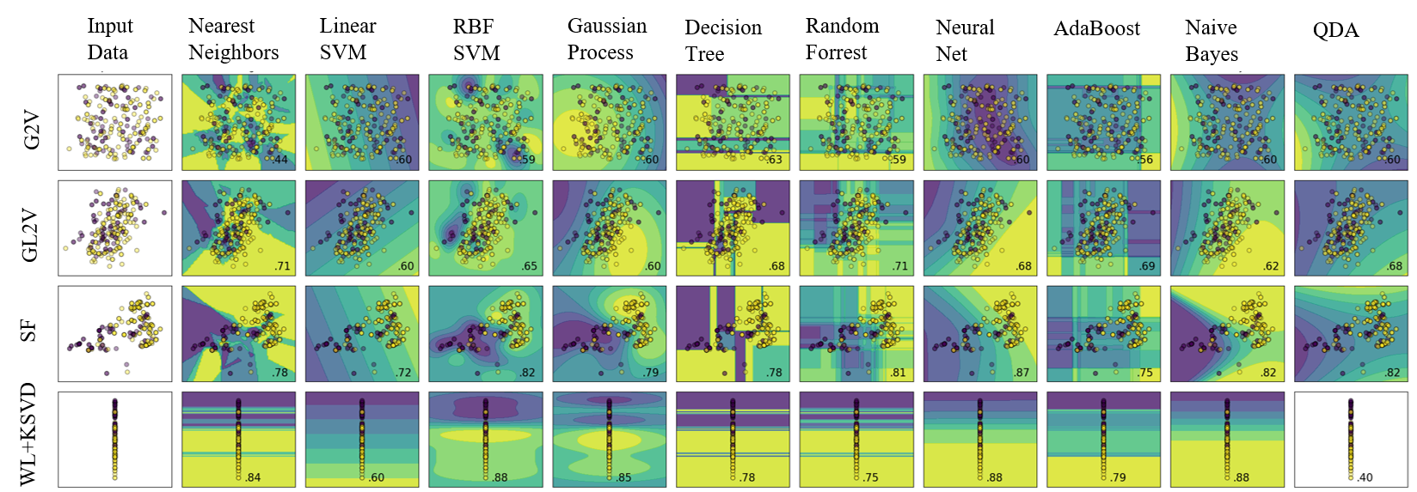
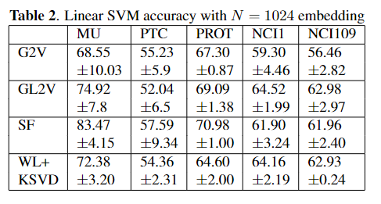
Preliminary results

Slide 31
Pipeline
Training
Testing
Train dataset
Test dataset
WL hash words
WL hash words
Vocabulary Training
Clustering Training
KSVD Dictionary train
KSVD
model
KSVD
OMP Infer
KSVD
OMP Infer
Clustering Training
Clustering
Validation
Clustering model train
Hyper-parameter
tuning
Clustering model
Clustering
predict

Slide 32
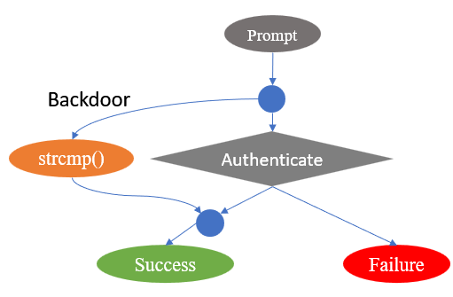
Identifying vulnerable subtree structures
Conceptual authentication bypass vulnerability

Slide 33
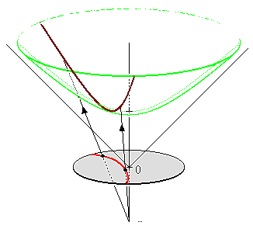
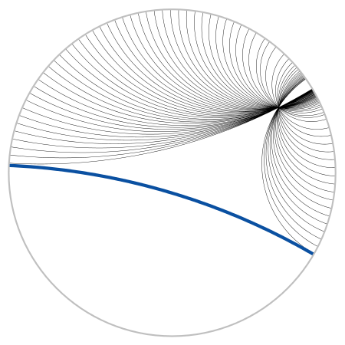
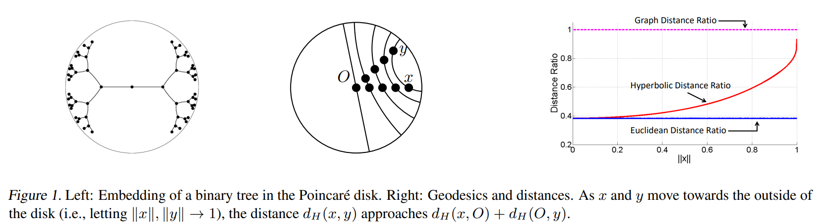
Hyperbolic space

Slide 34
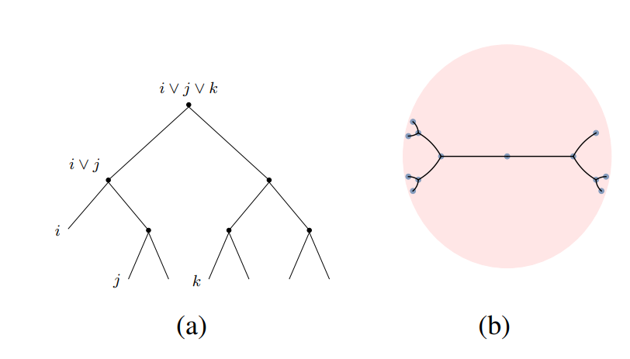
Hyperbolic space dictionary learning
Subtree embedding in Hyperbolic
Chami, I., Gu, A., Chatziafratis, V. and Ré, C., 2020. From trees to continuous embeddings and back: Hyperbolic hierarchical clustering. Advances in Neural Information Processing Systems, 33, pp.15065-15076.
SVD in hyperbolic
Onn, R., Steinhardt, A.O. and Bojanczyk, A., 1989, August. The hyperbolic singular value decomposition and applications. In Proceedings of the 32nd Midwest Symposium on Circuits and Systems, (pp. 575-577). IEEE.
K-means in hyperbolic
Djeddal, H., Touzari, L., Giovanidis, A., Phung, C.D. and Secci, S., 2021. Hyperbolic K-means for traffic-aware clustering in cloud and virtualized RANs. Computer Communications, 176, pp.258-271.
Pursuit algorithms in hyperbbolic
Tabaghi, P. and Dokmanić, I., 2020, August. Hyperbolic distance matrices. In Proceedings of the 26th ACM SIGKDD International Conference on Knowledge Discovery & Data Mining (pp. 1728-1738).

Slide 35
Q&A Summary
Objectives
Sparse dictionary learning on subtree patterns
Feature ranking of subtree patterns
Sparse representation on Hyperbolic space
Advantage
Linear relationship
Simpler (Low order) ML model
Intuitive
Outcomes
Publicly available python package

Slide 36
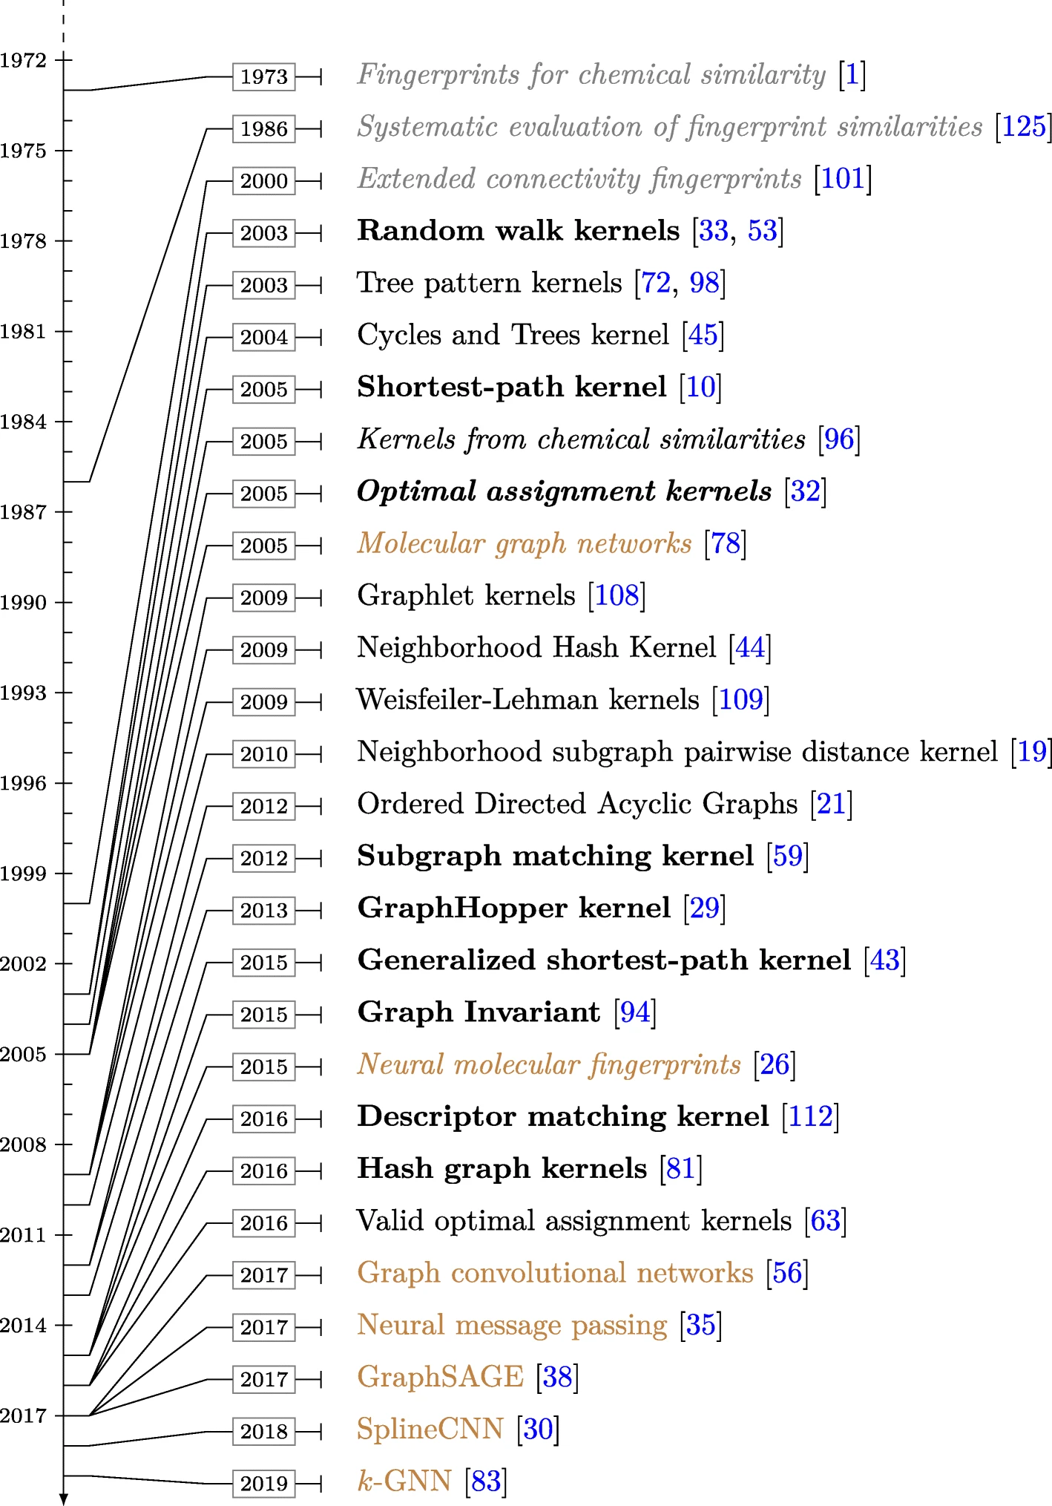
Graph Kernels

Slide 37
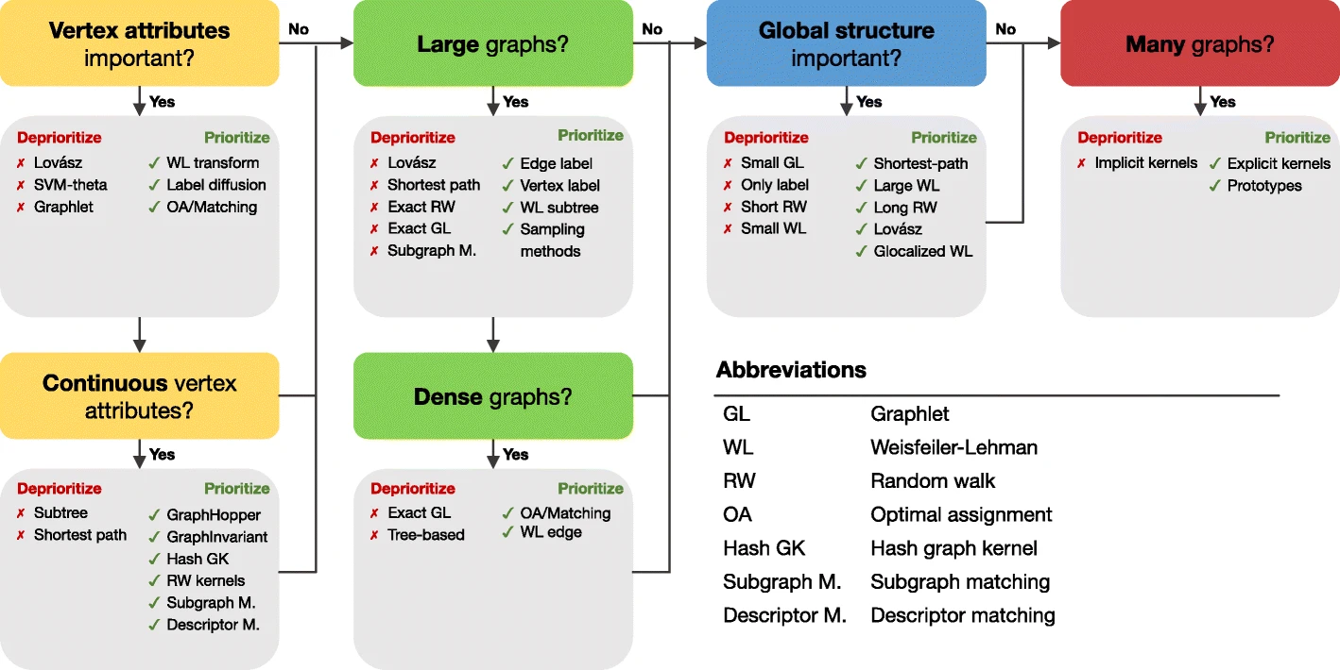
Graph Kernel selection guideline
Guidelines for prioritizing kernels for consideration based on known properties of the graph learning problem.

Slide 38
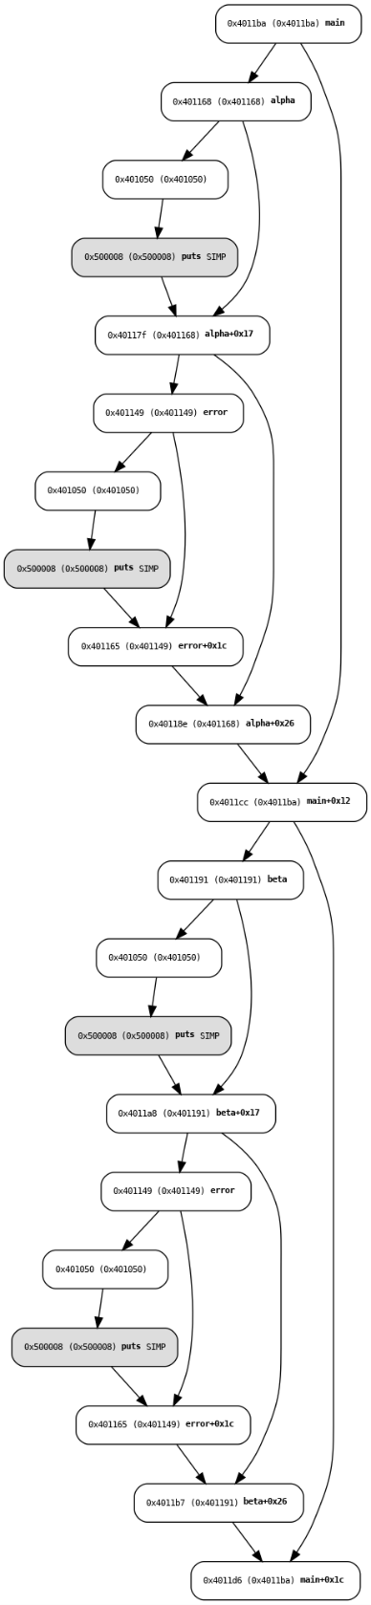
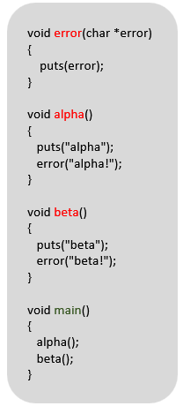
Typical CFG for a given program
Conceptual authentication bypass vulnerability

Slide 39
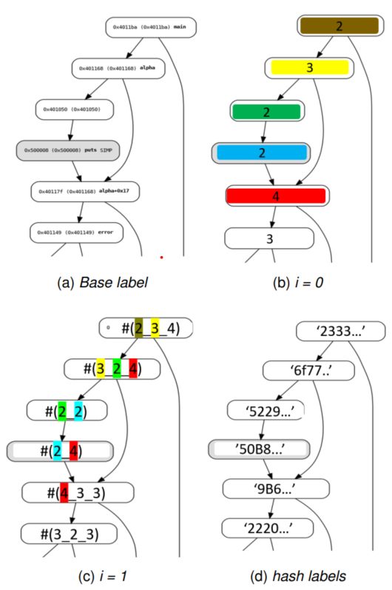
WL subtree hash relabeling
WL graph hash algorithms' first iteration in the context of CFG

Slide 40
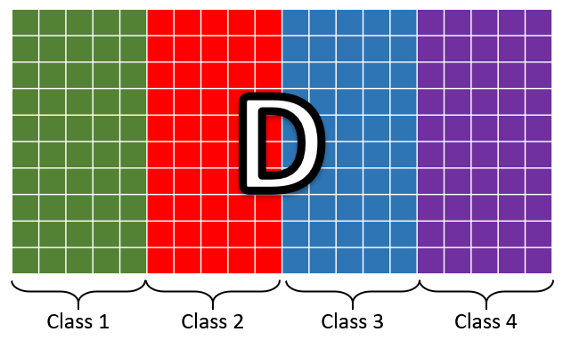
Supervised dictionary learning
Label Consistent-KSVD
Frozen-KSVD
D
“normal”
“abnormality-1”
“abnormality-2”

Slide 41
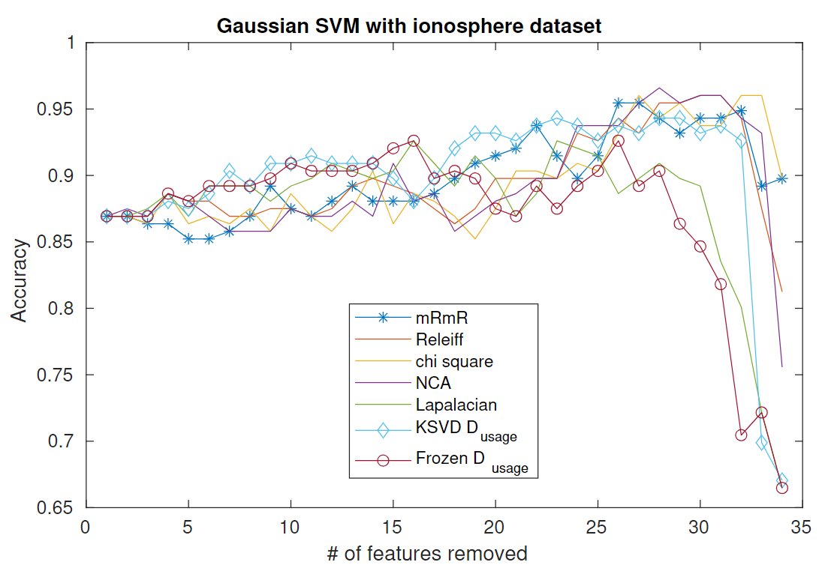
Feature selection

Slide 42
Overview
Introduction
Motivation
Problem
Goal
Background
Graph embedding
Sparse representation
Feature ranking
Objectives
Sparse dictionary learning on subtree patterns
Feature ranking of subtree patterns
Sparse representation on Hyperbolic space

